Slide 1


Book Recommender API
COMP3011
Sen Xu
School of Computing

Slide 2
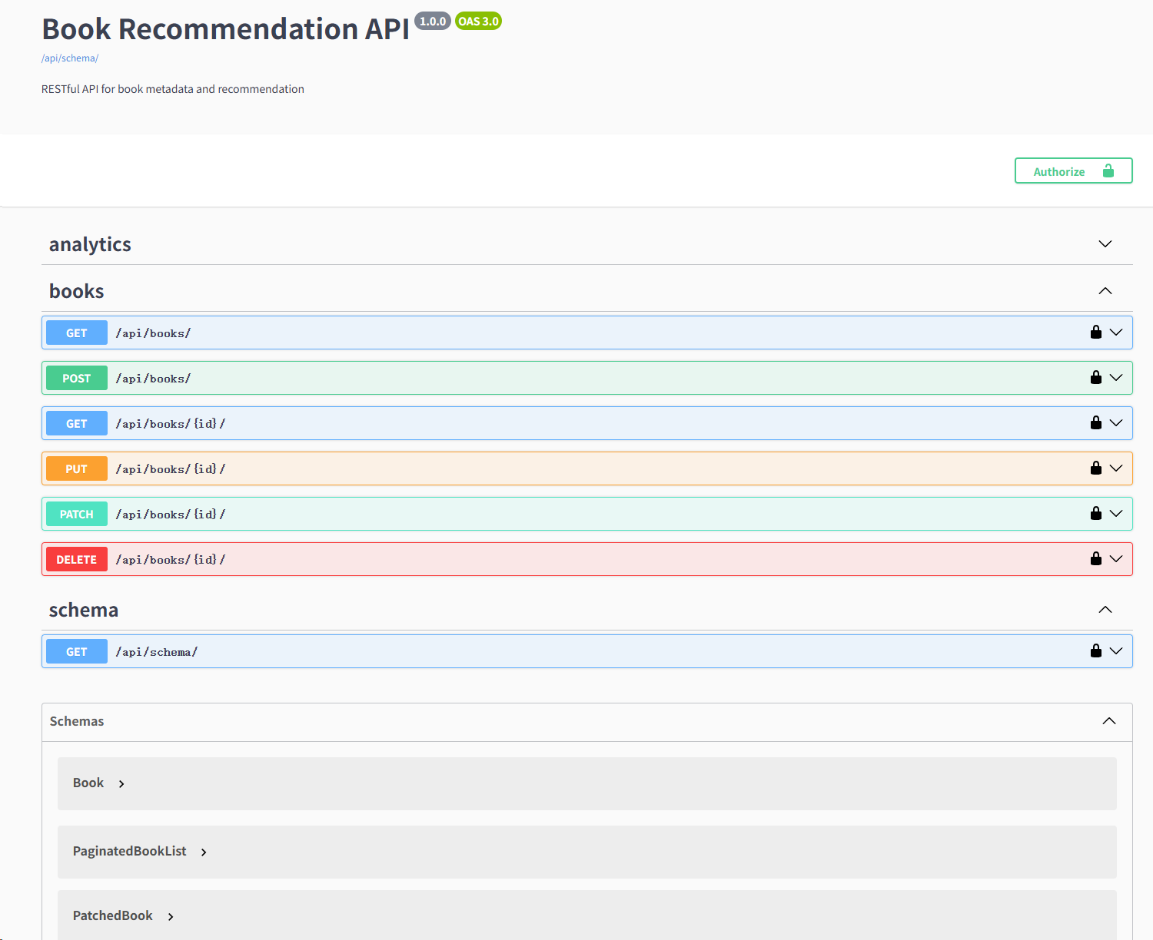
1 Project Overview
Goal
Build a RESTful Book Recommendation API that:
Stores book data
Provides recommendation functionality
Supports analytics queries
Exposes REST APIs
Core Features
Book CRUD API
Keyword based recommendation
Rating distribution analytics
Publisher statistics
Dataset
Goodreads Books Dataset

Slide 3
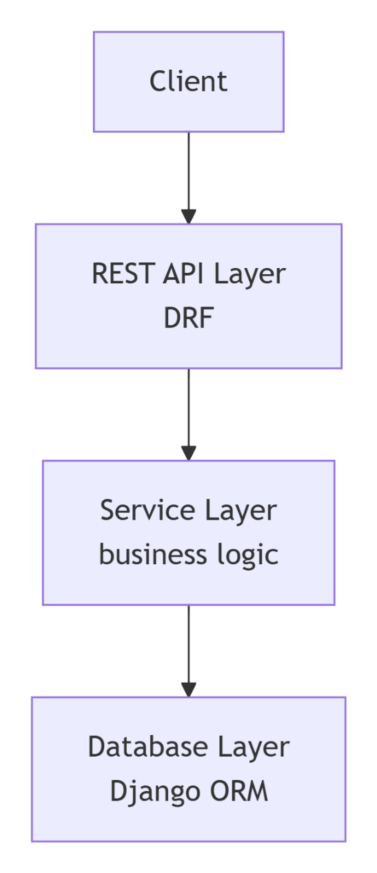
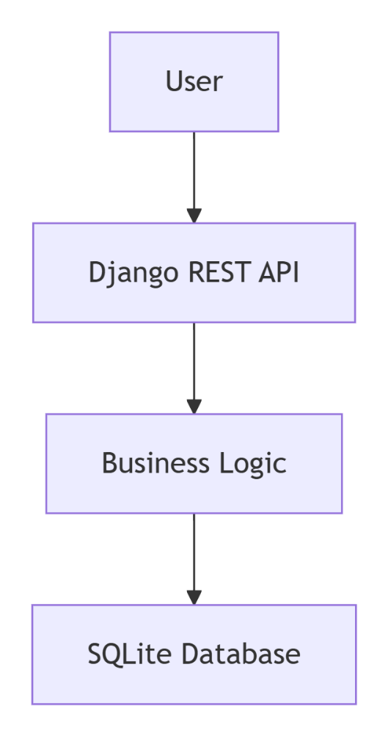
2 System Architecture
Backend Architecture
Backend Architecture
Components
Django Project
Books App
API Endpoints
Services
Database
Three-layer design

Slide 4


3 Technology Stack
Layer | Technology
Language | Python
Framework | Django
API Framework | Django REST Framework
Documentation | drf-spectacular
Database | SQLite
Dataset | Goodreads Books
Why did I choose Python + Django?
• Rapid development • Clean architecture • Built-in ORM • Strong ecosystem

Slide 5
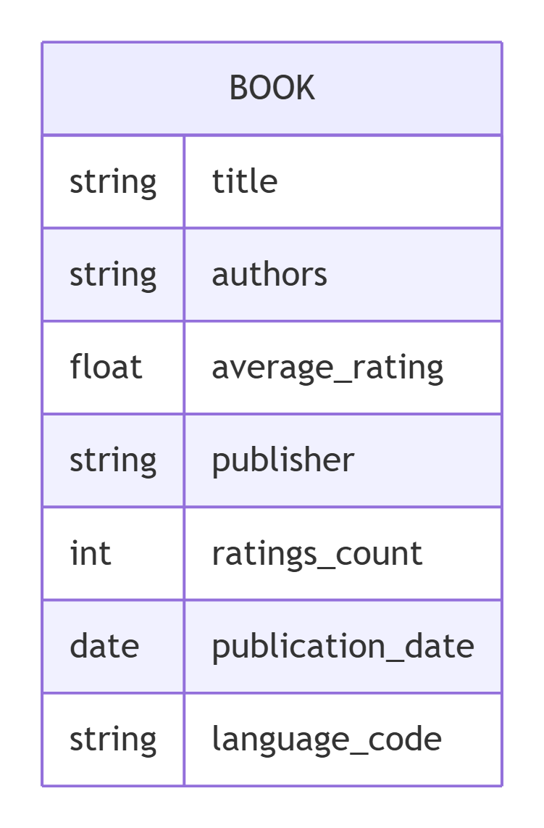
4 Database Design
Main Model
Book Model
Fields:
title authors average_rating publisher ratings_count publication_date language_code
Why Django ORM?
Simplifies database operations
Avoids raw SQL
Supports migrations

Slide 6
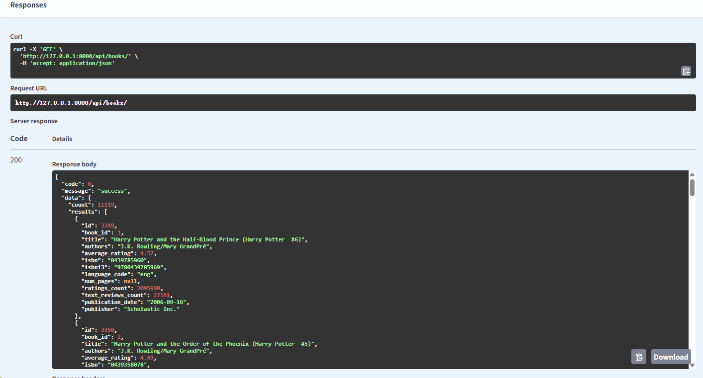
5 API Design
Endpoint | Method | Description
/api/books | GET | list books
/api/books | POST | create book
/api/books/{id} | GET | retrieve
/api/recommend | GET | recommend books
/api/analytics/ratings | GET | rating distribution
/api/analytics/publishers | GET | publisher statistics
Response Format
{
"code":0,
"message":"success",
"data":{}
}

Slide 7
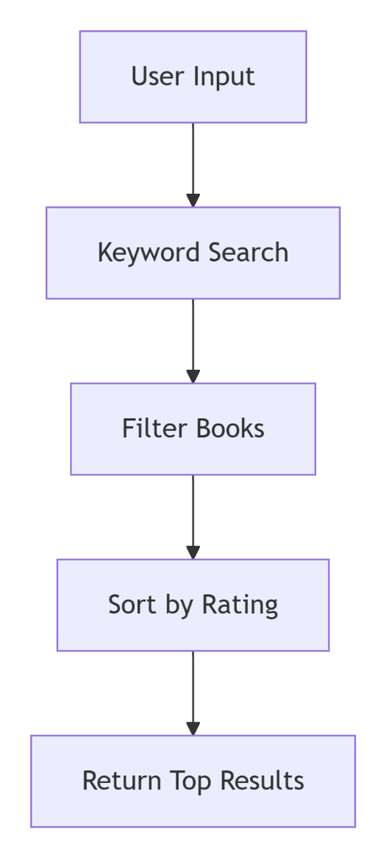
6 Recommendation Algorithm
Simple Recommendation Strategy
Search keyword from:
title
author
Query:
title__icontains
authors__icontains
Ranking:
average_rating DESC
Return:
Top 50 books

Slide 8
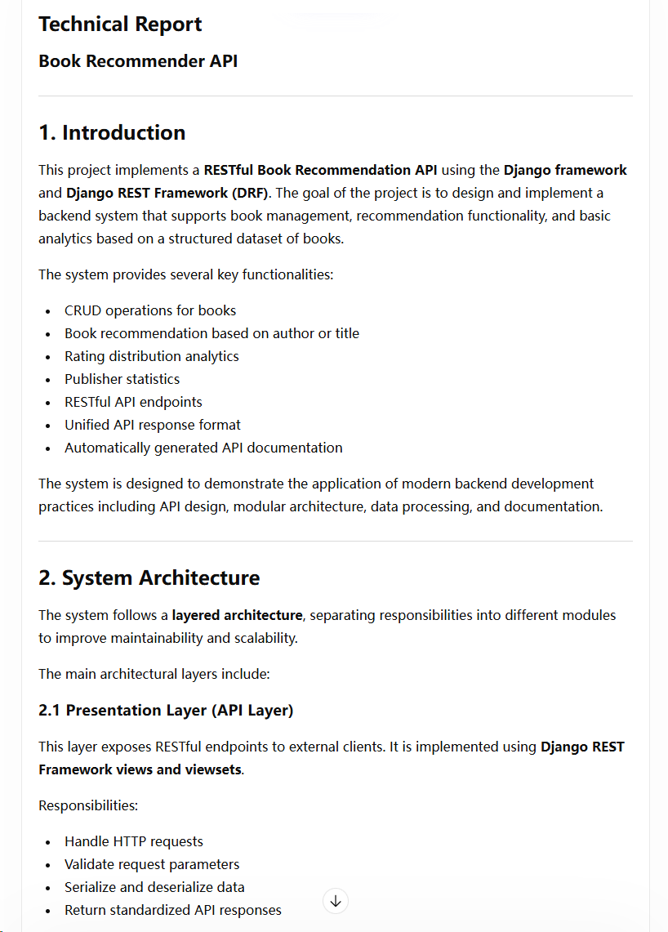

7 API Documentation
Generated using: drf-spectacular
Send schema.yml to GenAI,
and then let AI generate a report

Slide 9
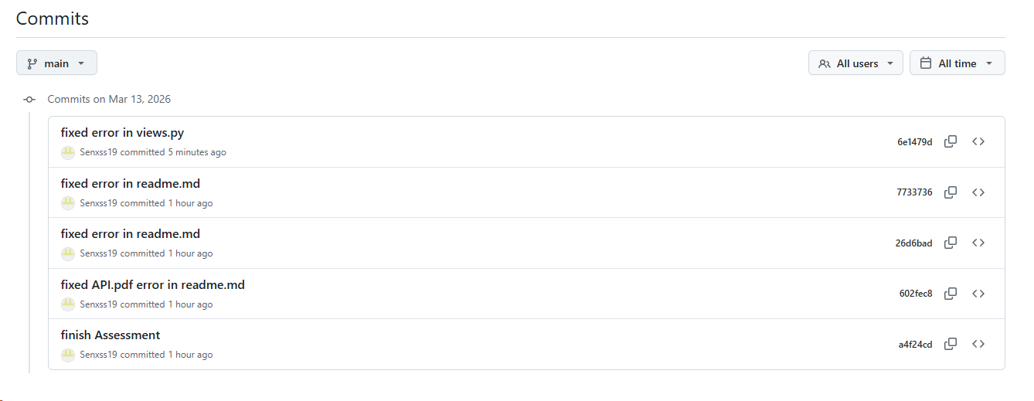
8 Version Control Practices
Repository hosted on:
GitHub
Version Control Workflow
• Feature-based commits
• Frequent commits
• Meaningful commit messages

Slide 10
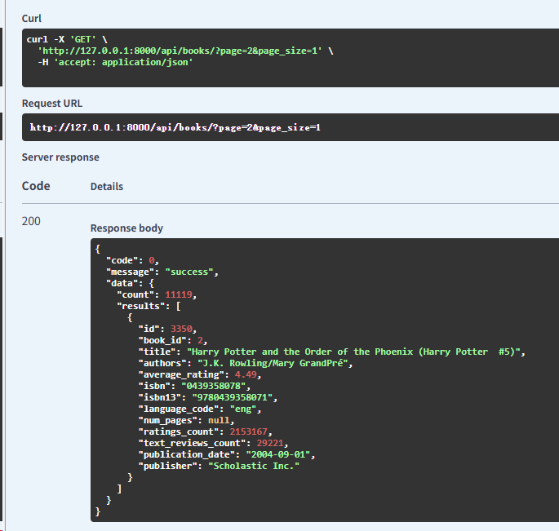
9 Challenges
Dataset Cleaning
Issues:
inconsistent data formats
missing values
date parsing
API Response Standardization
Needed consistent format for:
Success
Error
Pagination
Performance
Large dataset required pagination.

Slide 11
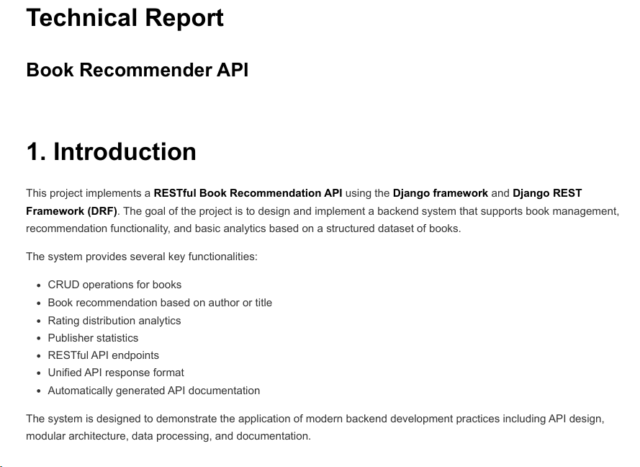
10 Technical Report Highlights
Key sections in the report:
• System architecture • Technology stack justification • Recommendation design • Testing methodology • Challenges and lessons learned • Limitations and future improvements
The report explains design decisions and development process.

Slide 12
11 Limitations and Future Improvements
Current limitations:
• simple recommendation algorithm • no authentication system • SQLite not suitable for production
These limitations are discussed in the technical report.
Advanced Recommendations
collaborative filtering
machine learning models
Performance
Redis caching
PostgreSQL
User Features
user accounts
user ratings
personalized recommendations

Slide 13
12 Conclusion
This project demonstrates:
• RESTful API design • backend architecture using Django • recommendation and analytics functionality • API documentation using OpenAPI
Key skills developed:
backend development
API design
database modeling
documentation

Slide 14
13 Thank You
Thank you for listening
Questions?

